Slide 1
Defensive Coding
Carlos.Leigue@Jalasoft.com

Slide 2
Agenda
Local Variables Declarations
IF statements
SWITCH statements
Enums
Casting

Slide 3
Defensive Coding
Local Variable Declarations
Location
Closer to its use
Initialization
If possible at declaration
Use of var keyword
When the type is obvious, clearly defined on the right hand side
Complex return types

Slide 4
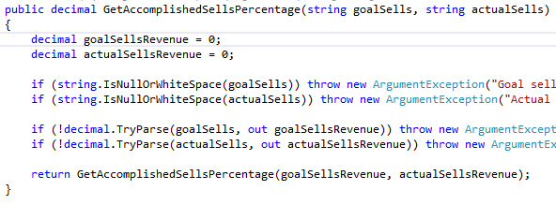
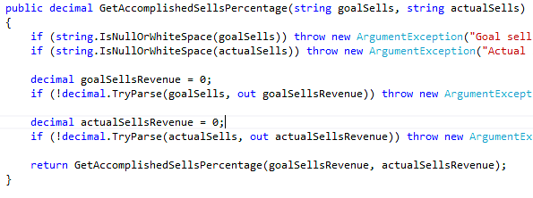
Defensive Coding
Local Variable Declarations - Location

Slide 5
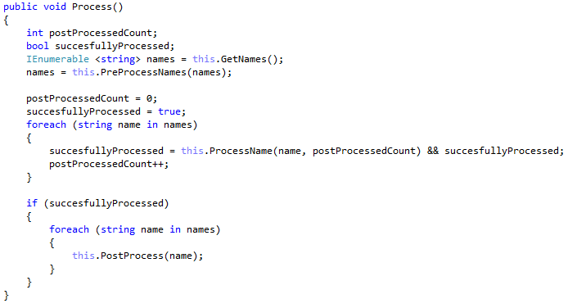
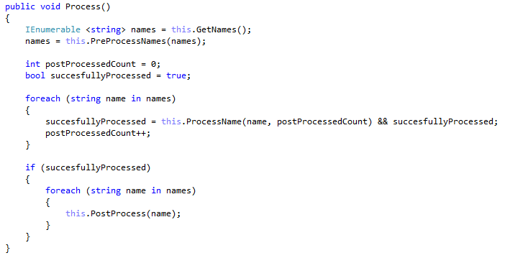
Defensive Coding
Local Variable Declarations - Initialization

Slide 6

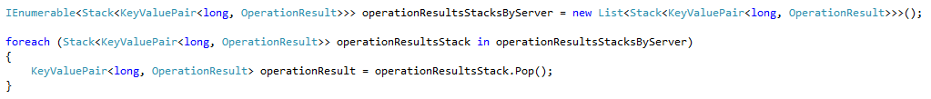
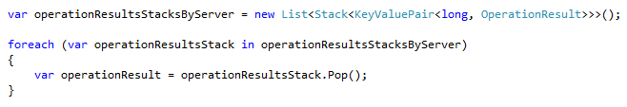
Defensive Coding
Local Variable Declarations - var
vs
vs

Slide 7
Defensive Coding
IF statements
IFs with single statements
Risks:
Doing quick changes
Working over the same code, version control merges
Best practices:
Long statement, use braces
Short statement, could be place next to the IF in the same line
Corporate standards may define alternative requirements.

Slide 8
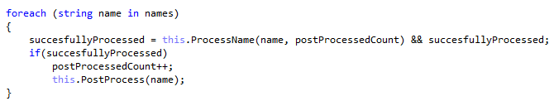


Defensive Coding
IF statements
or
or

Slide 9
Defensive Coding
IF statements
Consider the ELSE case, if needed
If feasible, use Positive IF statements
Nested IFs, consider refactoring if several IF statements
are nested

Slide 10
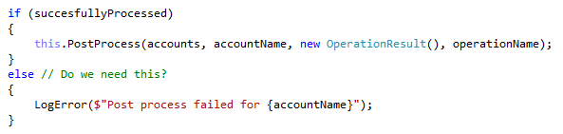
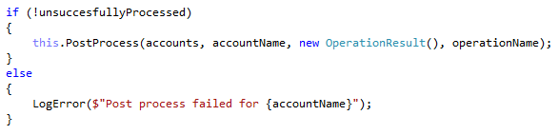
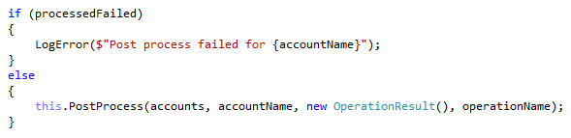
Defensive Coding
IF statements

Slide 11
Defensive Coding
SWITCH statements
Order your cases, use logical sequences
Do not forget the default case, be predictable
Cases should be simple, otherwise should call other methods

Slide 12
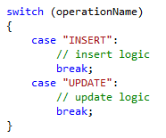
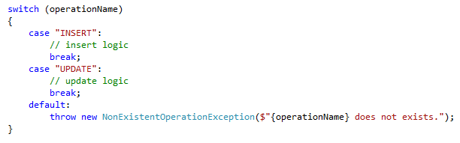
Defensive Coding
SWITCH statements
logical sequence? Numerical, functional
handle default cases

Slide 13
Defensive Coding
Enums
Type, allows members to be described in words, discrete sets.
In certain cases help us removing “magic numbers”
Avoid nesting Enums inside a class

Slide 14
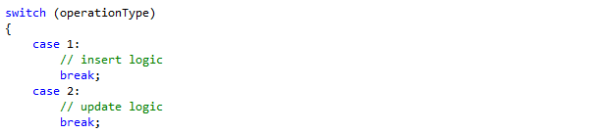
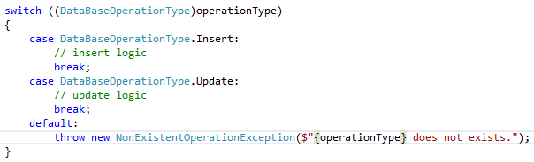
Defensive Coding
Enums
magic numbers
cases purpose is clear

Slide 15


Defensive Coding
Enums
vs

Slide 16

Defensive Coding
Enums

Slide 17
Defensive Coding
Casting
Type conversion, one type of data to another
Blind casting
is, as operators, safe casting and verification

Slide 18

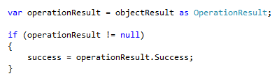
Defensive Coding
Casting
blind casting
safe casting

